Slide 1


How to be an amazing independent learner
Aim:
To explore memory skills which can be applied to any piece of information.
To learn about reducing / chunking / blocking of information to make it manageable.
To use memory skills to make a lot of information stick in your memory.

Slide 2

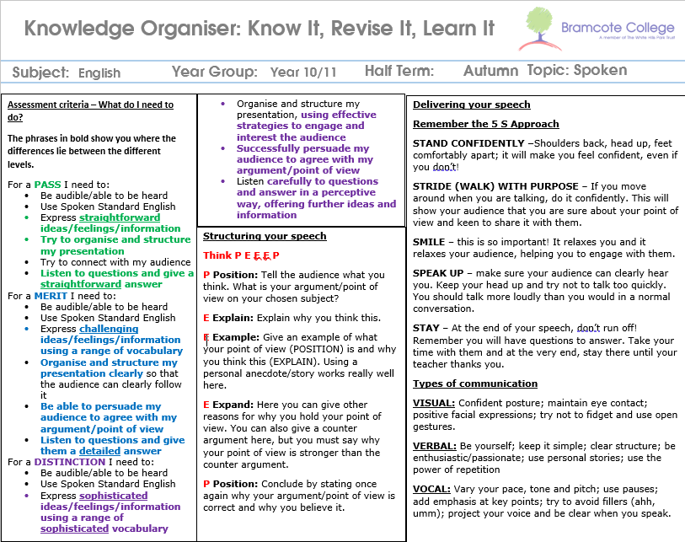

How am I ever going to get THIS much information in my head … for every topic … for every subjects
Mind blown?

Slide 3
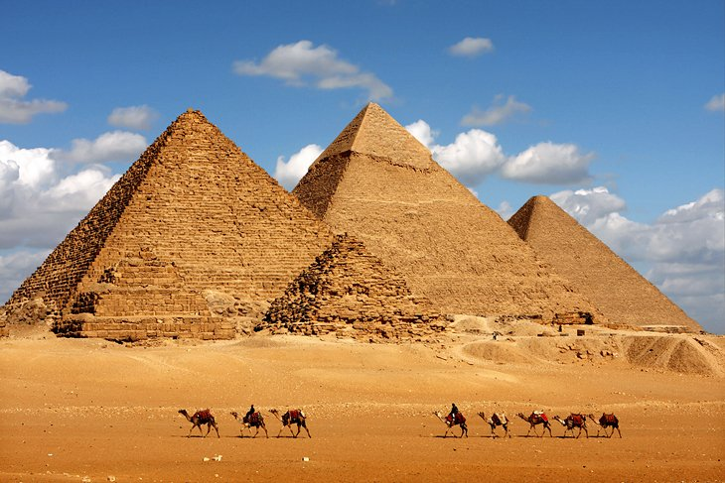
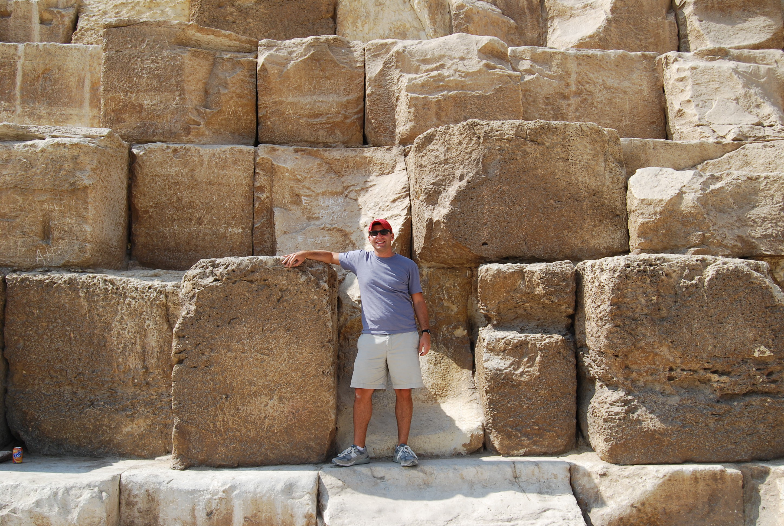
You’re basically trying to build a pyramid
with the grade you want at the top …
These were built about 4,500 years ago … no cranes, diggers, machinery, conveyor belts … so how on earth was it done?
One stone at a time …
Each stone is a bit of knowledge or a skill you need to get the grade you want … you just need to start now and build it stone by stone until you’ve got your pyramid

Slide 4
The builders knew what the pyramids should look like
Read the three grades – what’s the difference between them?
Summarise Merit & Distinction grade in 4 or 5 words
e.g. Pass = Straightforward, try, organise
For the grade you WANT explain what each of your 4 or 5 words mean or what they would look like …
e.g. ‘basic’ = some point that show you understand but it’s a bit vague or a bit short …
‘detailed’ = with evidence and well explained and three or more points …
So just focus on the mark scheme – so you know what to aim for
If drawing isn’t like torture to you … you could add some little pictures to make these points more memorable

Slide 5
ALL (!) the things you need
to remember to do when you’re aiming to get the grade you want
Delivering your speech
Remember the 5 S Approach
STAND CONFIDENTLY –Shoulders back, head up, feet comfortably apart; it will make you feel confident, even if you don’t!
STRIDE (WALK) WITH PURPOSE – If you move around when you are talking, do it confidently. This will show your audience that you are sure about your point of view and keen to share it with them.
SMILE – this is so important! It relaxes you and it relaxes your audience, helping you to engage with them.
SPEAK UP – make sure your audience can clearly hear you. Keep your head up and try not to talk too quickly. You should talk more loudly than you would in a normal conversation.
STAY – At the end of your speech, don’t run off! Remember you will have questions to answer. Take your time with them and at the very end, stay there until your teacher thanks you.
Types of communication
VISUAL: Confident posture; maintain eye contact; positive facial expressions; try not to fidget and use open gestures.
VERBAL: Be yourself; keep it simple; clear structure; be enthusiastic/passionate; use personal stories; use the power of repetition
VOCAL: Vary your pace, tone and pitch; use pauses; add emphasis at key points; try to avoid fillers (ahh, umm); project your voice and be clear when you speak.
So you’ve got to do ALL of this while your brain is full of adrenaline … which makes you want to fight or run in stressful situations
You need a memory trick to try to remember this …
Have you ever played the tea tray game?
Look at the objects on the next screen … TRY to remember as many objects as you can …

Slide 6

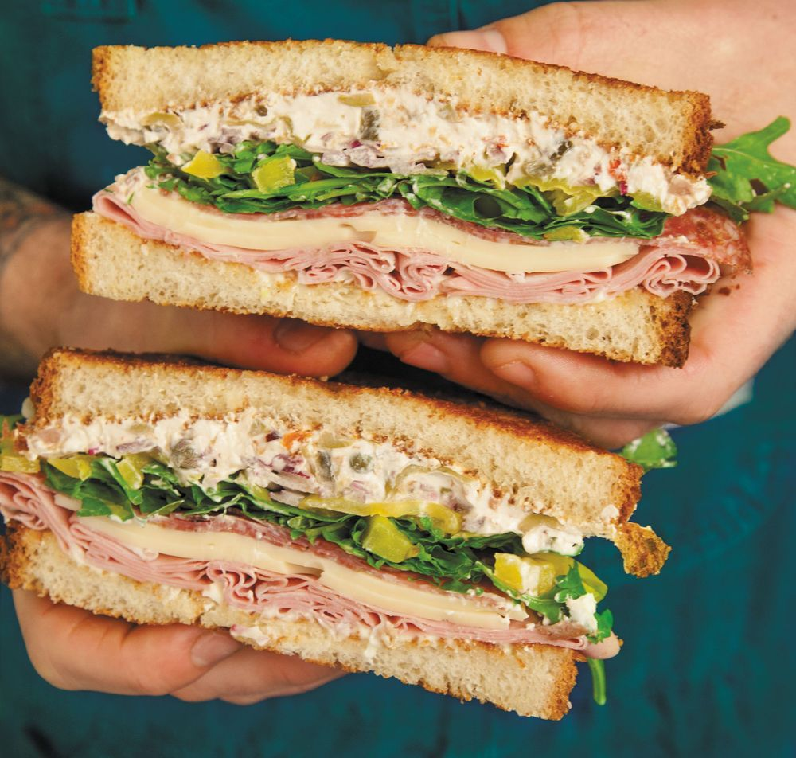





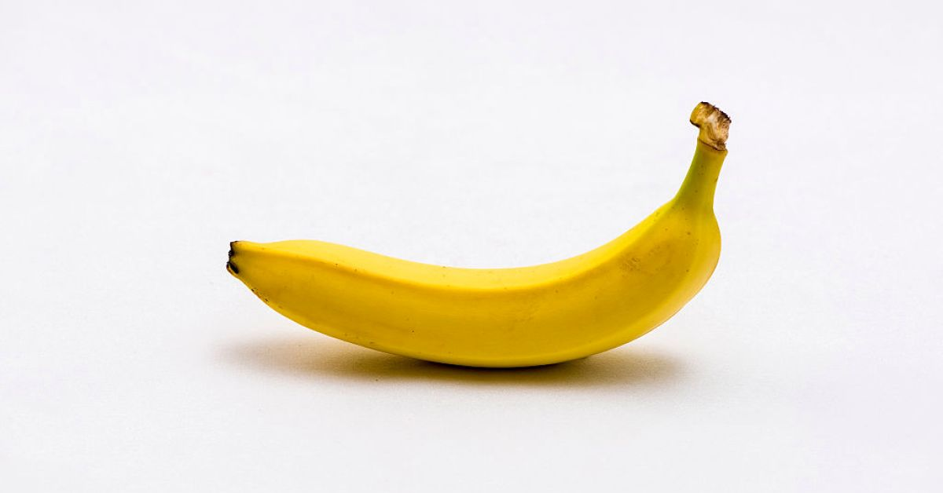
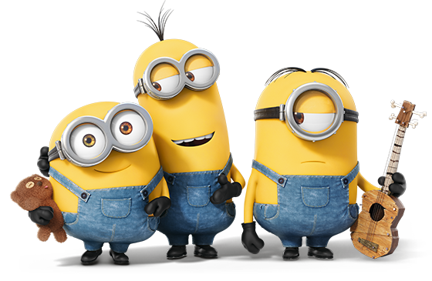
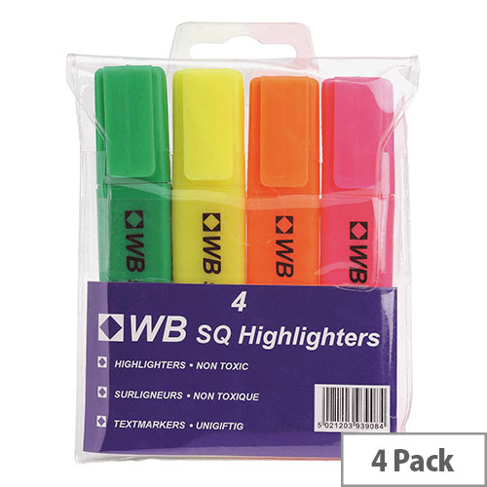
NOW write down everything you can remember …
For a higher mark … add more details … colours, brands, flavours, special features etc.

Slide 7
What made them memorable?
Did you get them all? Most people can remember 6 easily … after that, you need to remember them by ‘memorable features’ … colour … links between objects … e.g. at Christmas I got an X Box and a pair of trainers and some chocolate
What other links can you spot between these items to make them memorable?

Slide 8
So … again … how are you going to remember ALL of this?!!?!?!
Delivering your speech
Remember the 5 S Approach
STAND CONFIDENTLY –Shoulders back, head up, feet comfortably apart; it will make you feel confident, even if you don’t!
STRIDE (WALK) WITH PURPOSE – If you move around when you are talking, do it confidently. This will show your audience that you are sure about your point of view and keen to share it with them.
SMILE – this is so important! It relaxes you and it relaxes your audience, helping you to engage with them.
SPEAK UP – make sure your audience can clearly hear you. Keep your head up and try not to talk too quickly. You should talk more loudly than you would in a normal conversation.
STAY – At the end of your speech, don’t run off! Remember you will have questions to answer. Take your time with them and at the very end, stay there until your teacher thanks you.
Types of communication
VISUAL: Confident posture; maintain eye contact; positive facial expressions; try not to fidget and use open gestures.
VERBAL: Be yourself; keep it simple; clear structure; be enthusiastic/passionate; use personal stories; use the power of repetition
VOCAL: Vary your pace, tone and pitch; use pauses; add emphasis at key points; try to avoid fillers (ahh, umm); project your voice and be clear when you speak.
Remember … that pictures were memorable … would a list of words have been as memorable as the pictures? Why not?
Pictures make information memorable …
Colours make links to your memory too (purple Cadburys) …
Labels (brand names) can make the most important points stand out …
But not too much information …
Look at this HUGE amount of advice about how to present well … produce a cartoon strip, or a pictogram, a labelled cartoon character showing what you need to remember … especially to get the grade you want.

Slide 9
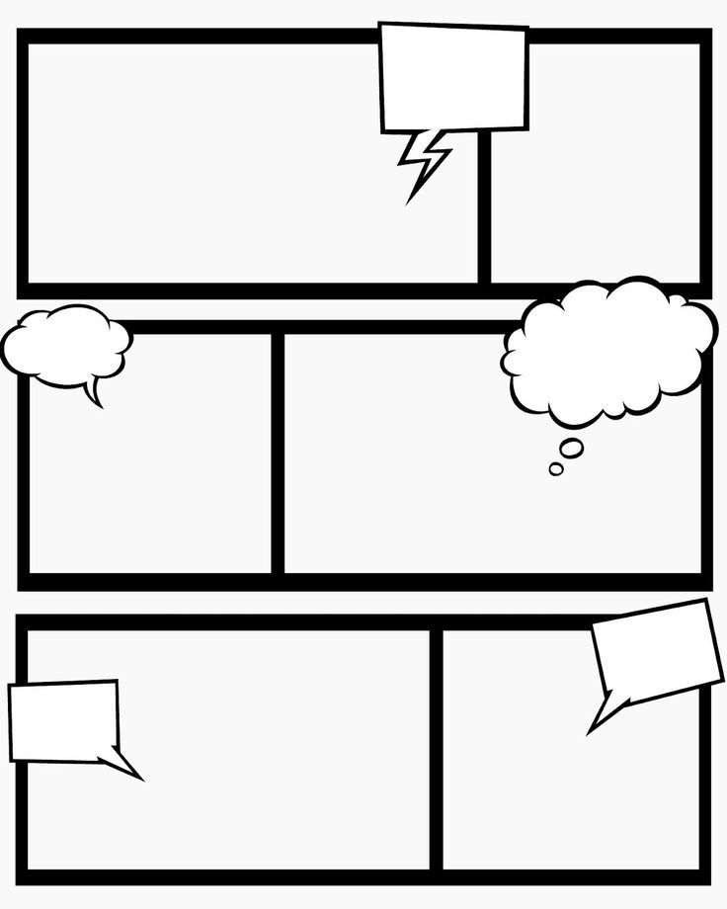

Plan your speech
Speak slowly & clearly
Don’t cross your arms
Stand confidently
Don’t fidget or pace

Slide 10
Next Lesson …
This lesson we have …
Explored memory skills which can be applied to any piece of information.
Learned about reducing / chunking / blocking of information to make it manageable.
Used memory skills to make a lot of information stick in your memory.
Next lesson we’re going to have a look at how you can remember pairs of information …
Key words & meanings
Dates & events
Quotes & characters
Symbols & words
And about being confident to use the language and concepts you’re learning.

